Slide 1
Mass Spectrometry Imaging in Detecting Tumor Heterogeneity
Under supervision of: Dr/ Ahmed morsy
Systems and Biomedical Engineering
Represented By:
Ibrahim Elsayed Sec: 1 BN: 1
Donia Abd Elsalam Sec: 1 BN: 30
Renad Taher Sec: 1 BN: 34
Mariem Ahmed Sec: 2 BN: 29
Mustafa Yehia Sec: 2 BN: 33
|Date: 24/7/2021 |Time: 3:00 PM |Location: Electronics Lab

Slide 2
Motivation

Slide 3
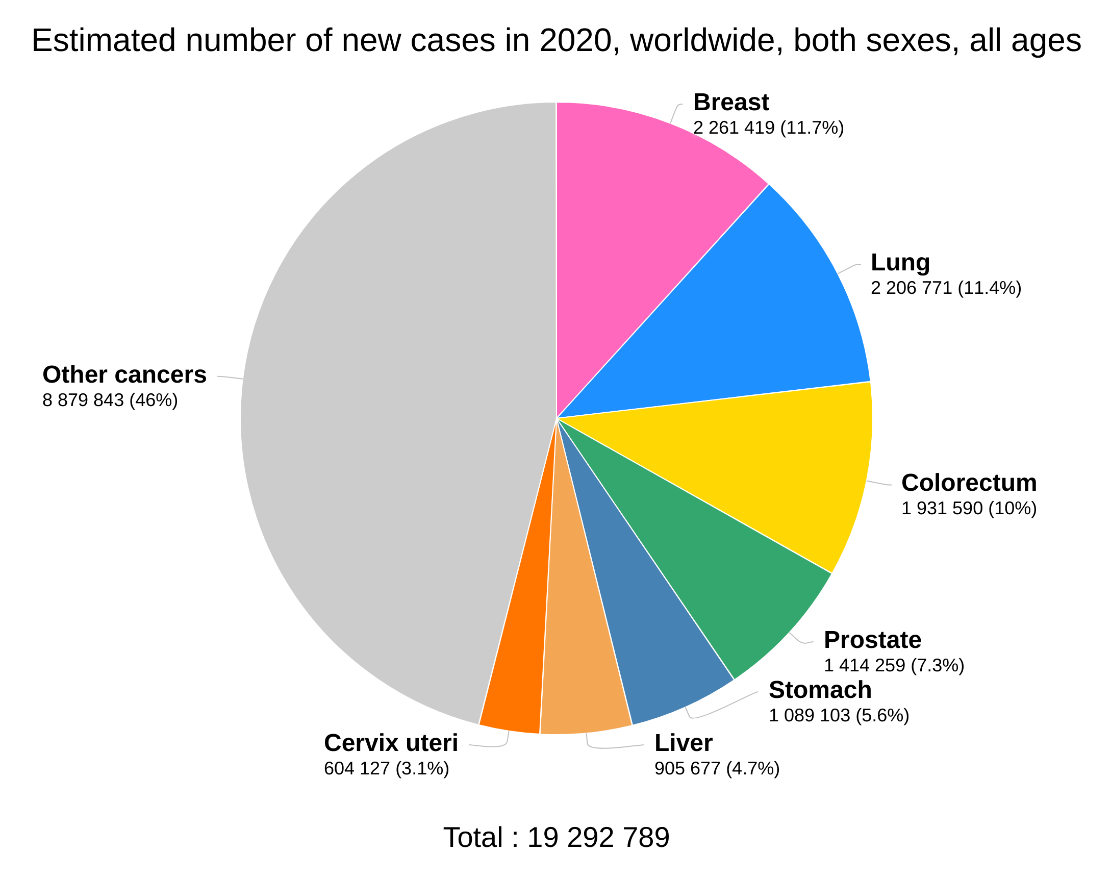
Introduction
Cancer Evolution
Cancer Statistics
Cancer Detection Techniques
Old Techniques | New Techniques
Magnetic Resonance Imaging (MRI) | Tumor Subpopulations
Nuclear Medicine | Mass Spectrometry Imaging (MSI)

Slide 4
Objective
Investigate the effect of intratumor heterogeneity on the overall survival time of patients (For Gastric Cancer).
Investigate the effect of metastasis tumor on the overall survival time of patients (For Breast Cancer).

Slide 5
Milestone
Some visualizations to understand data
1
Gastric/Breast Cancer
2
3
Applying PCA & t-SNE
Data Preprocessing
Exploratory Data Analysis
Dimensionality Reduction
Sam Analysis
Gastric cancer classification
Breast Cancer
Study probability of a patient to live or die
K-means Application
4
5
6
Clustering Data
Survival Analysis
Further Work

Slide 6
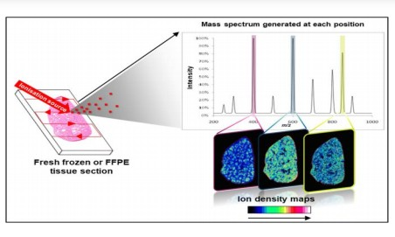

Today's Agenda
Mass Spectrometry Imaging (MSI)
Dimensionality Reduction
Clustering
Survival Analysis
Microarray Analysis Technique
Fisher’s Exact Test
Value of Our Work
Further Work

Slide 7

Today's Agenda
Mass Spectrometry Imaging (MSI)
Dimensionality Reduction
Clustering
Survival Analysis
Fisher’s Exact Test
Microarray Analysis Technique
Value of Our Work
Further Work
Mustafa Yehia

Slide 8
Mass Spectrometry Imaging (MSI)
Molecular Level
Total Ion Count
Feature Space
Technique | Specialization
SIMS | Lipids
MALDI | Proteins, Peptides
DESI | Both

Slide 9
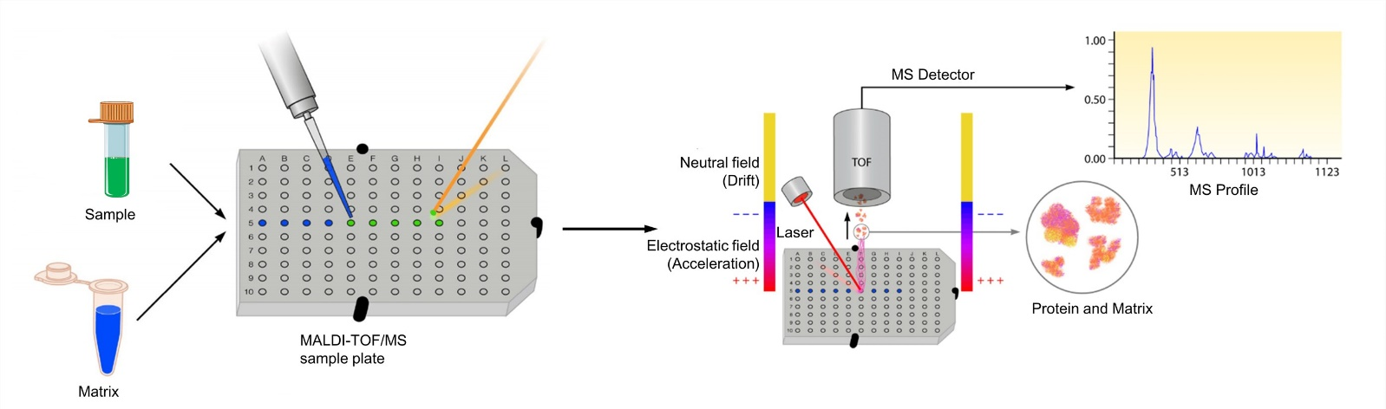
MALDI

Slide 10

Today's Agenda
Mass Spectrometry Imaging (MSI)
Dimensionality Reduction
Clustering
Survival Analysis
Fisher’s Exact Test
Microarray Analysis Technique
Value of Our Work
Further Work
Ibrahim Elsayed

Slide 11
Curse of Dimensionality
It occurs when we try to analyze or organize the data in the high-dimension space.
These phenomena occur in different domains such as numerical analysis, machine learning, etc.…..

Slide 12
Dimensionality Reduction
There are two types of techniques
Linear techniques, e.g. PCA
Non-Linear techniques, e.g. t-SNE

Slide 13
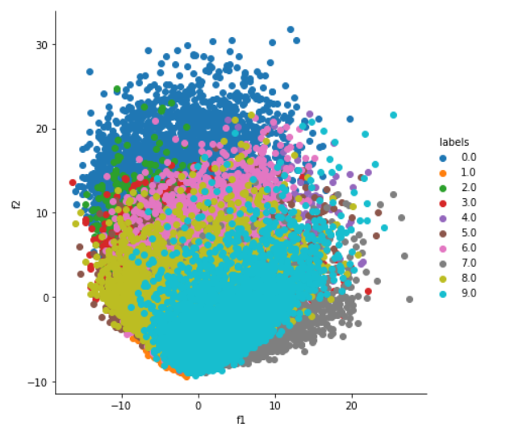
Principal component analysis (PCA)
It is a linear dimensionality reduction technique that can be utilized for extracting information from a high-dimensional space.

Slide 14
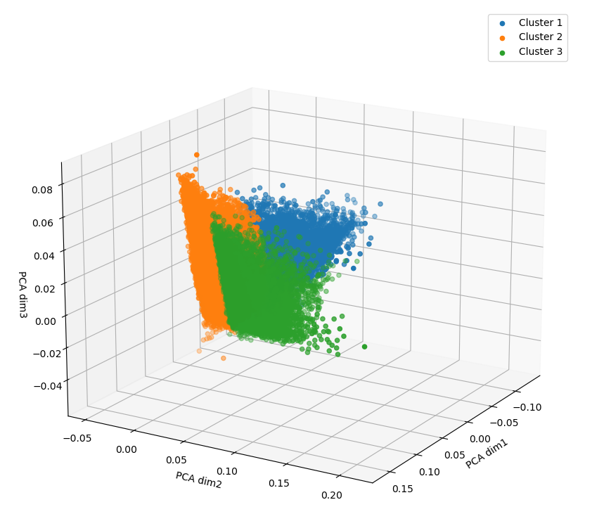
Principal component analysis (PCA)
PCA in MSI data to reduce the dimensionality from 82-D ‘number of proteins’ to 3-D in the space.

Slide 15
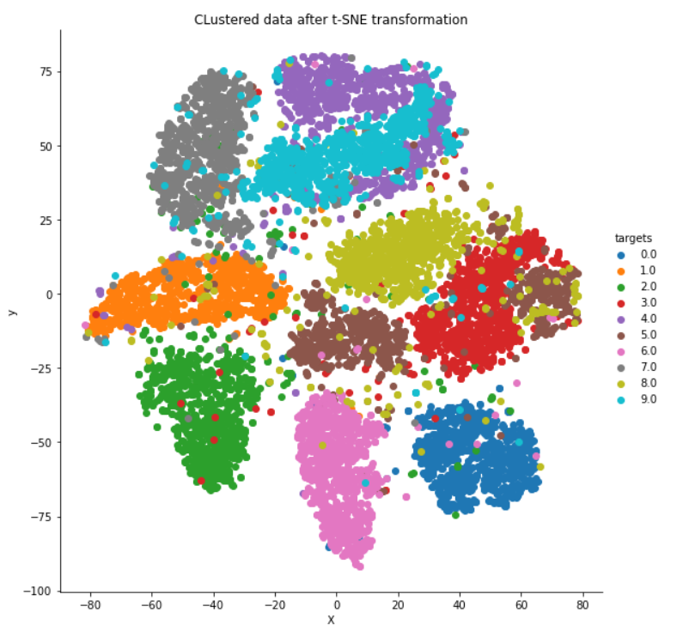
t-SNE
A nonlinear dimensionality reduction technique.
preserves local structure at the same time preserving the global structure.

Slide 16
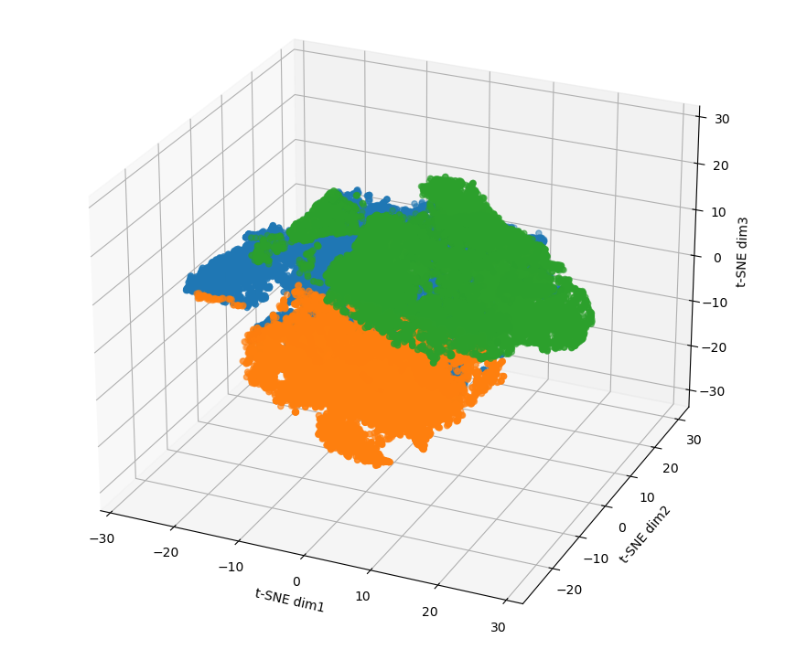
t-SNE in Gastric Cancer
The t-SNE scatterplot reveals clear structural separations based on molecular heterogeneity.

Slide 17
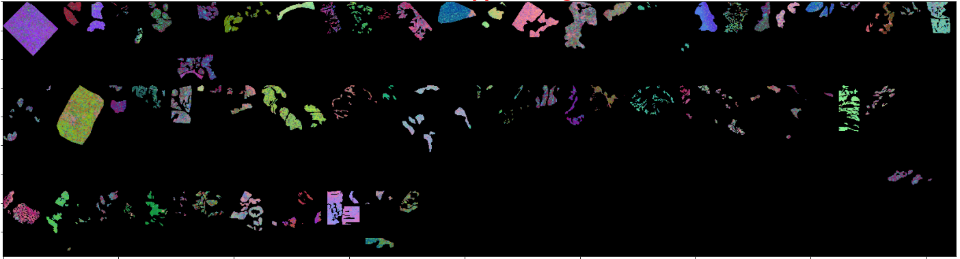
t-SNE in Gastric Cancer
This was done by representing every pixel of data in high dimension to one point in the low dimensional space.

Slide 18
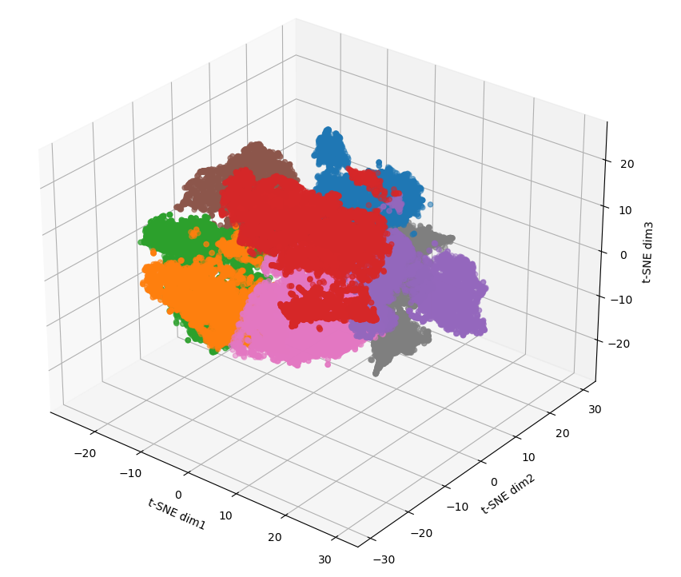
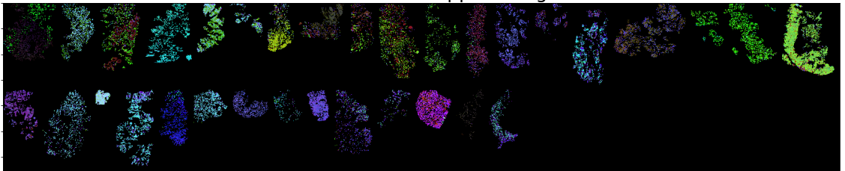
t-SNE in Breast Cancer

Slide 19

Today's Agenda
Mass Spectrometry Imaging (MSI)
Dimensionality Reduction
Clustering
Survival Analysis
Fisher’s Exact Test
Microarray Analysis Technique
Value of Our Work
Further Work
Mariem Ahmed

Slide 20
Clustering

Slide 21
K-means Clustering

Slide 22

Today's Agenda
Mass Spectrometry Imaging (MSI)
Dimensionality Reduction
Clustering
Survival Analysis
Fisher’s Exact Test
Microarray Analysis Technique
Value of Our Work
Further Work
Donia Abd Elslam

Slide 23
Survival Analysis

Slide 24

Today's Agenda
Mass Spectrometry Imaging (MSI)
Dimensionality Reduction
Clustering
Survival Analysis
Fisher’s Exact Test
Microarray Analysis Technique
Value of Our Work
Further Work
Renad Taher

Slide 25
Fisher’s Exact Test

Slide 26
Today's Agenda
Mass Spectrometry Imaging (MSI)
Dimensionality Reduction
Clustering
Survival Analysis
Fisher’s Exact Test
Microarray Analysis Technique
Value of Our Work
Further Work
Mustafa Yehia

Slide 27
Microarray Analysis Technique

Slide 28
Significance Analysis of Microarray (SAM)

Slide 29
Today's Agenda
Mass Spectrometry Imaging (MSI)
Dimensionality Reduction
Clustering
Survival Analysis
Fisher’s Exact Test
Microarray Analysis Technique
Value of Our Work
Further Work

Slide 30
Value of Our Work

Slide 31
Today's Agenda
Mass Spectrometry Imaging (MSI)
Dimensionality Reduction
Clustering
Survival Analysis
Fisher’s Exact Test
Microarray Analysis Technique
Value of Our Work
Further Work

Slide 32
Further Work

Slide 33
Conclusion
What ideas are accepted?
1. … … …
2. … … …
3. … … …
4. … … …
5. … … …
What ideas are rejected?
1. … … …
2. … … …
3. … … …
4. … … …
5. … … …

